Slide 1

Learning from Data 11 May 2023 Group Assignment Analyzing investment strategies
H van dijk (223227354)
mc lebese (219042116)
b nqwaba (219115748)

Slide 2
Objective
Identify 4 exchange traded funds best suited for future investment.
Analyze historical data of the selected exchange traded funds.
Use regression techniques to establish future growth potential.
Select fund to invest R100k and motivate the selection taking other economic factors into account.

Slide 3
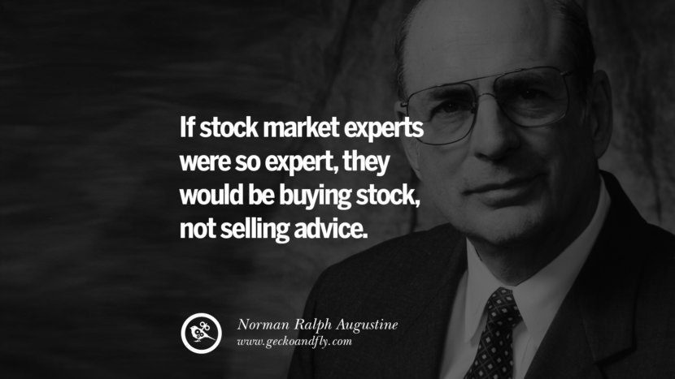
Importance of doing your own research…!!!

Slide 4
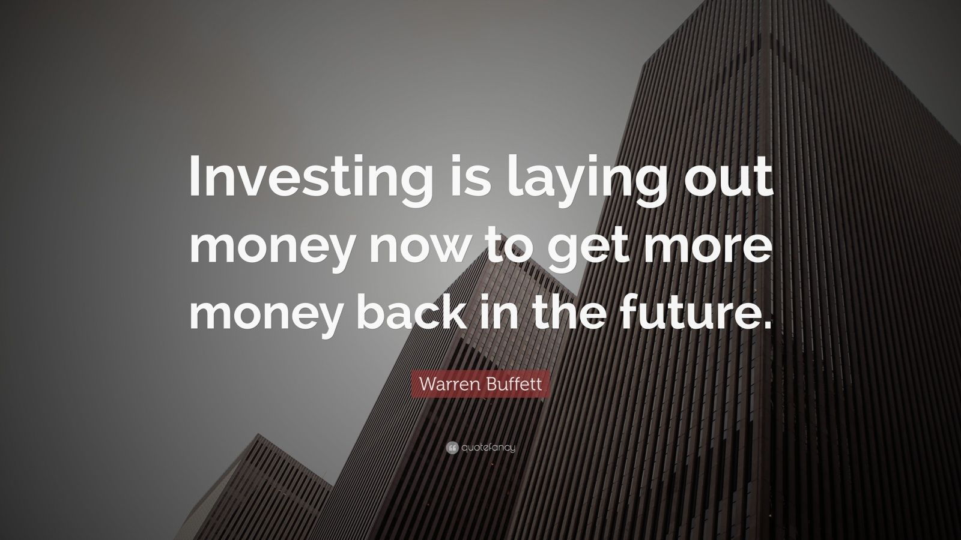
Why should we invest?

Slide 5
Exchange Traded Funds
What is an ETF ?
An Exchange Traded Fund (ETF) is a structured investment instrument specifically created to track the performance of an existing stock, a particular index, commodities, or any specific asset.
(What is an Exchange Traded Fund (ETF), 2023)
Why ETF
Diversification, which helps mitigate and lower the risk of the investor’s portfolio, may be one of the essential strategies to endure the market’s volatility better. Rather than researching and identifying each stock and instrument to invest in to pursue optimal asset allocation, investors are afforded several methods they may utilise to diversify their portfolio. One security available at an investor’s disposal is an Exchange Traded Fund (ETF).
(What is an Exchange Traded Fund (ETF), 2023)

Slide 6
ETF’s Identified
Vanguard S&P 500:
The S&P 500 represents 500 of the largest U.S. companies. The goal of the Vanguard S&P 500 ETF is to track the returns of the S&P 500 index
Satrix 40:
This ETF tracks the FTSE/JSE Top 40 Index, which is a market capitalization-weighted index that comprises the 40 largest companies listed on the Johannesburg Stock Exchange (JSE).
Satrix Indi:
This ETF tracks the FTSE/JSE Africa Index Series, which is a market capitalization-weighted index that comprises the 25 largest companies listed on the JSE that are not included in the FTSE/JSE Top 40 Index.
Sygnia Itrix MSCI World ETF:
This ETF tracks the performance of the MSCI World Index, which is a market capitalization-weighted index that comprises companies from 23 developed countries around the world.

Slide 7
Data Gathered
Source: https://za.investing.com
Monthly Share Price Data collected across all 4 ETF’s
USD/ZAR exchange rate Data
https://github.com/HenkVanDijk-hub/GroupAssignment4InvAnalysis.git
Analytics was done using both Python and Excel.
All graph presentations were done using Python.

Slide 8
Descriptive analysis
S&P 500 and Signia Itirx MSCI reflecting higher growth.
Impact of USD/AR Exchange Rate.
Flat shareprice performance but declining Rand echange result in higher Rand fund price.

Slide 9
Regression analysis (Formula Example)
The least squared regression trend line was used to plot a growth trend.
Example on the left includes the calculation for the Vanguard S&P 500 ETF.
Within Excel the “TREND” function can be used to do the same calculation.
This regression formula was used to forecast future growth.
The following slides will present the linear trends in a graph.

Slide 10
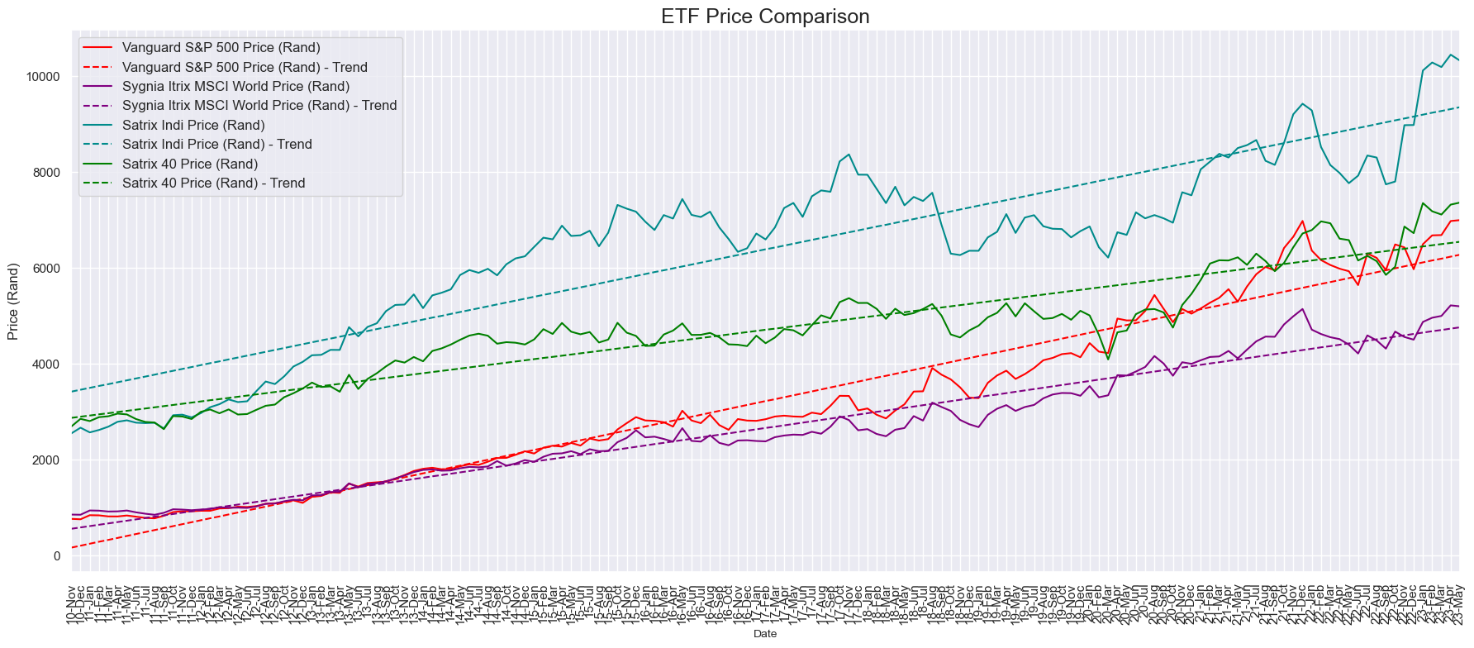
All ETF’s reflected long term growth in ZAR:
Trend lines uses the least squares regression analysis methodology
All the funds reviewed reflected growth over the period under review although some funds performed better than others.

Slide 11
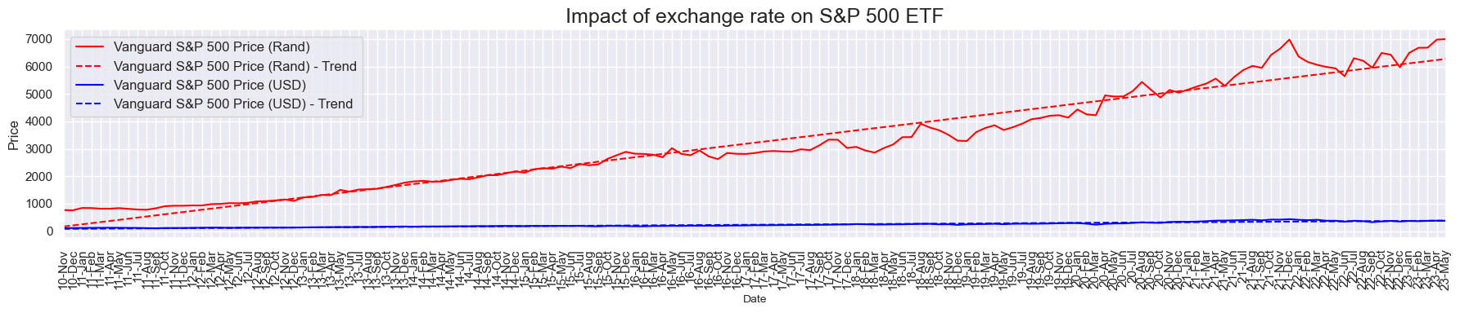
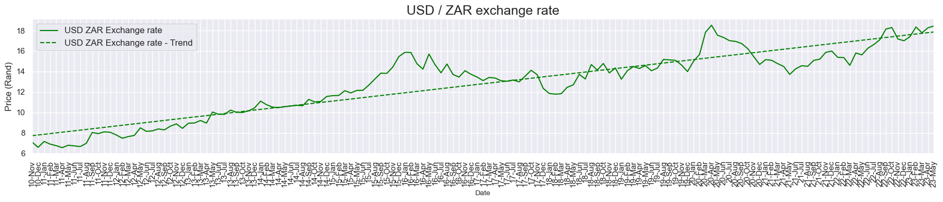
Exchange rate impact on investments:
Although the S&P 500 Price reflected extremely low growth i.t.o USD, the fund showed significant growth in SA rands due to the increase in exchange rate highlighting the importance of taking exchange rate into account when analysing ETF performance.

Slide 12
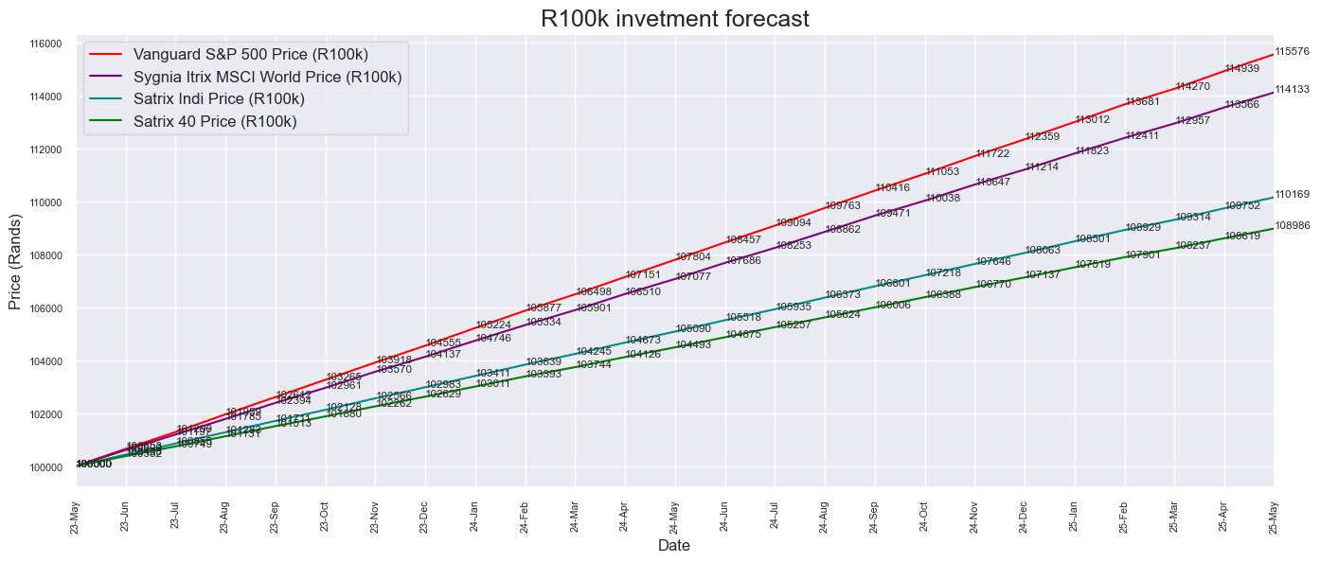
R100k investment forecasted growth
Forecast uses the least squares regression analysis methodology
The S&P 500 Index outperforms the other funds in terms growing the R100k investment to R 115 576 (15,6%) over the next 2 years.
The Sygnia Itrix MSCI fund shows more moderate growth of 14% over next two year growing the R100k investment to R 114 133.

Slide 13
Other factors impacting analysis.
Vanguard S&P 500:
This fund is highly susceptible to changes in exchange rate.
Growth in this fund could mainly be attributed to the exchange rate.
Satrix 40 / Satrix Indi :
These fund tracks performance of SA companies.
SA Economic growth forecast remain low. National Treasury’s baseline forecast for GDP growth remain low at 0.9% for 2023.
Increased energy concerns put additional pressure on SA companies.
Sygnia Itrix MSCI World ETF:
This fund is slightly more diversified tracking the performance of the MSCI World Index comprising of companies from 23 developed countries around the world.

Slide 14
Conclusion.
We have selected the Sygnia Itrix MSCI World ETF to invest our R100k because of the following:
The fund is more diversified tracking 25 developed countries world wide.
It had the second highest return of the funds but is less reliant on the USD/ZAR exchange rate.
It excludes exclusively SA markets where future economic growth is uncertain diven by energy concerns.
The fund reflected stable growth over the past 12 years.

